Slide 1


Slide 2
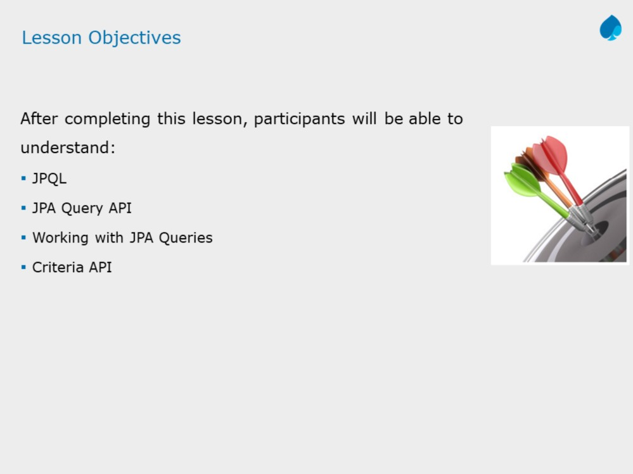

Slide 3
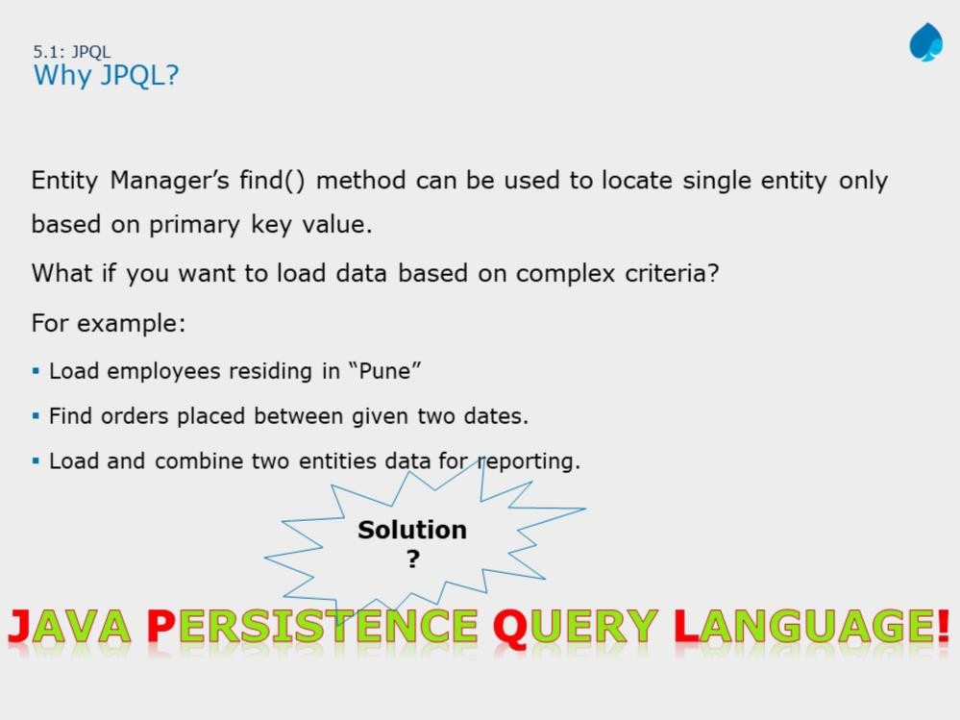

Slide 4
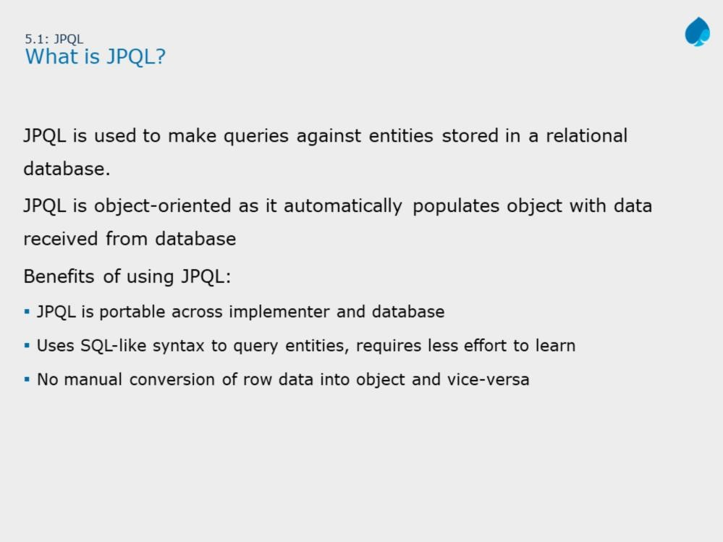
JPA with Hibernate 3.0
Instructor Notes:
Discuss major issues of JDBC. For example, we need to do a manual conversion of rows from database to objects vice versa.

Slide 5
The Java Persistence Query Language (JPQL) is a platform-independent object-oriented query language defined as part of the Java Persistence API (JPA) specification.
JPQL is used to make queries against entities stored in a relational database.
The JPQL defines queries for entities and their persistent state. The query language allows you to write portable queries that work regardless of the underlying data store.
The JPQL can be considered as an object oriented version of SQL. Users familiar with SQL should find JPQL very easy to learn and use.
The main difference between SQL and JPQL is that SQL works with relational database tables, records and fields, whereas JPQL works with Java classes and objects.

Slide 6
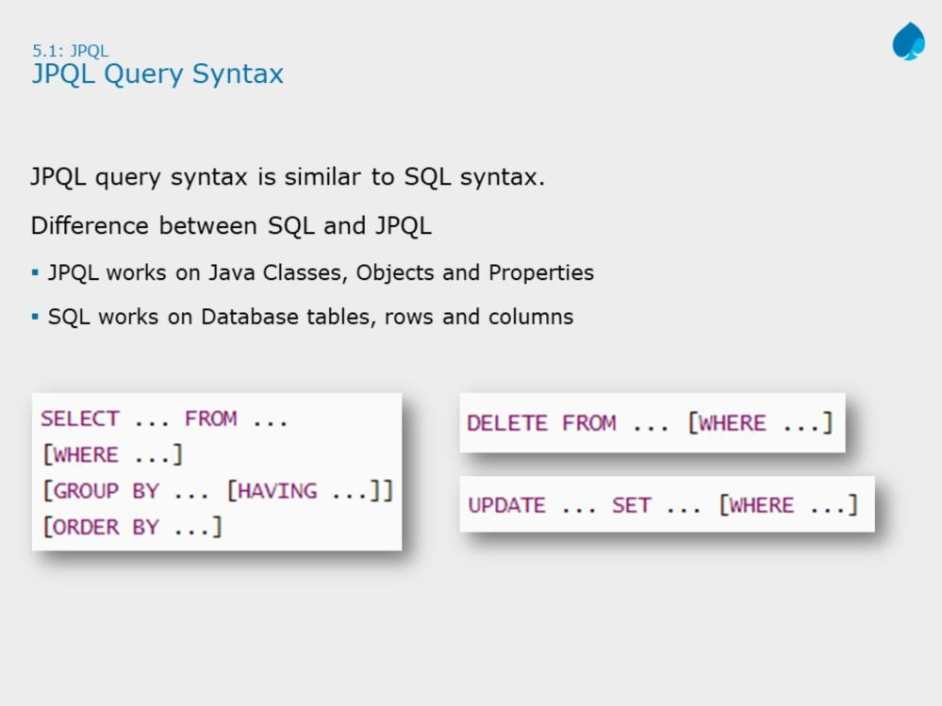

Slide 7
As shown in the slide, there is no difference between SQL and JPQL query syntax. Consider the following Entity class,
@Entity
public class Book implements Serializable { @Id
private Long id;
private String bookTitle; private String author; private Double price;
// getter and setter methods
}
If you want to find all books written by author ‘Jim Kathy’, then you need to write JPQL select statement on above entity class as given below:
SELECT b.id,b. bookTitle,b.price FROM Book b
WHERE b.author = ‘Jim Kathy’;
--property reference
--object reference
Where as the below query counts total books object available in data store.
SELECT COUNT(b.id) FROM Book b;

Slide 8
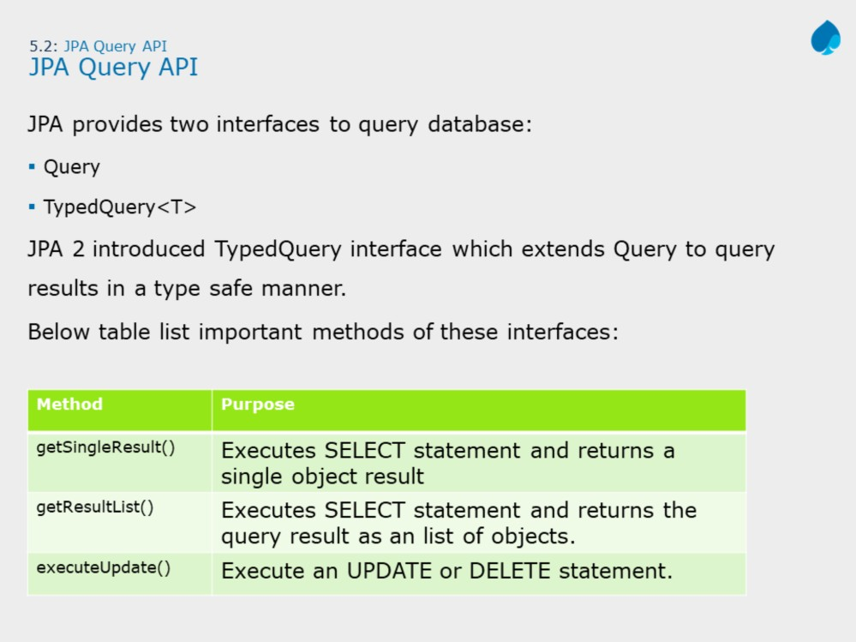

Slide 9
Queries are represented in JPA 2 by two interfaces - the old Query interface, which was the only interface available for representing queries in JPA 1, and the new TypedQuery<T> JPA interface that was introduced in JPA 2.
The TypedQuery interface extends the Query interface.
It is easier to run queries and process the query results in a type safe manner when using the TypedQuery interface.
The Query/TypedQuery<T> interface defines two methods for running SELECT queries:
getSingleResult() - for use when exactly one result object is expected.
getResultList() - for general use in any other case.
For UPDATE and DELETE use executeUpdate() method.
Note: The Query interface should be used mainly when the query result type is unknown or when a query returns polymorphic results. When a more specific result type is expected, use the TypedQuery interface.

Slide 10
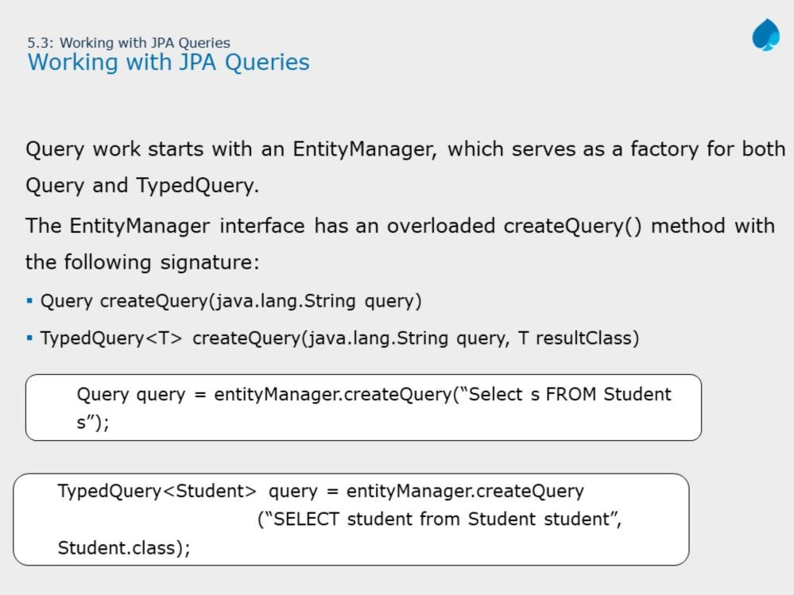

Slide 11
EntityManager interface has a createQuery method with the following signature:
<T> TypedQuery<T> createQuery(java.lang.String jpqlString, java.lang.Class<T> resultClass)
The first argument is JPQL string query and second argument is the typed class, which indicates return object type, upon query execution.

Slide 12
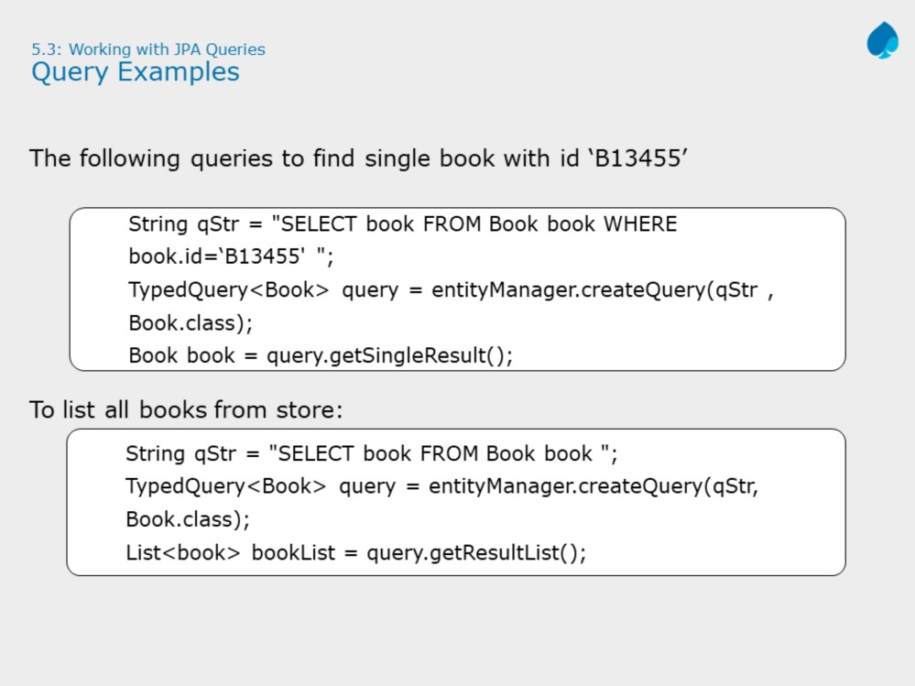

Slide 13
Query interface should be used mainly when the query result type is unknown or when a query returns polymorphic results and the lowest known common denominator of all the result objects is Object.
When a more specific result type is expected queries should usually use the TypedQuery.
Note: For type safety and to avoid runtime cast exceptions, it is always good practice to work with TypedQuery<T>.

Slide 14
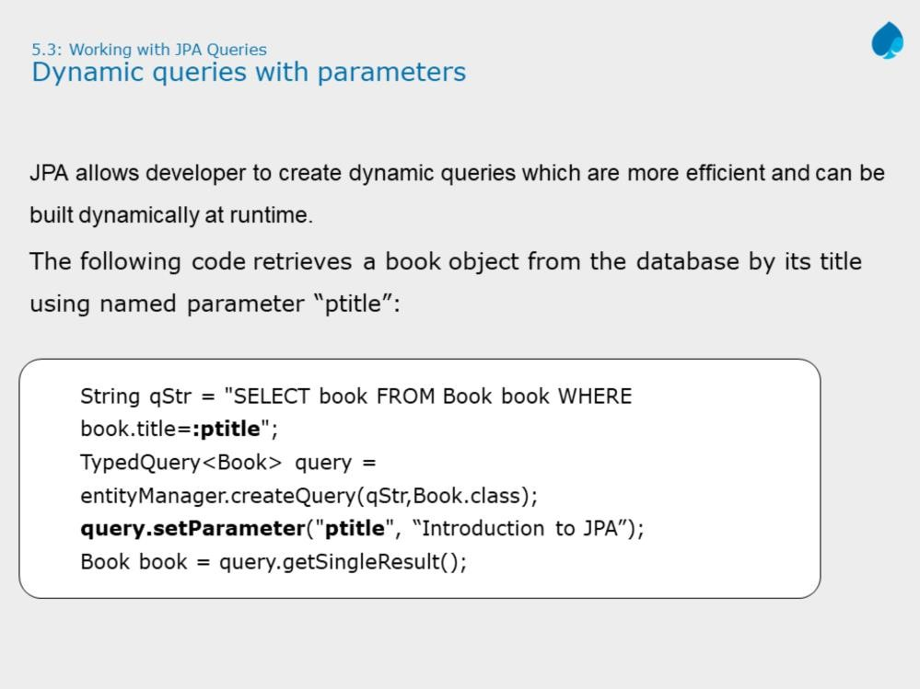

Slide 15
Query parameters enable the definition of reusable queries. Such queries can be executed with different parameter values to retrieve different results.
There are multiple ways to pass parameters to query.
Named Parameters (:name)
Ordinal Parameters (?index)
Criteria Query Parameters
The slide example shows example of named parameter “ptitle”, which is later injected using setParameter() method on query.
Note: Named parameters should always preceded by colon (:).
While setting the date related parameters, one should make use of TemporalType to indicate a specific mapping of java.util.Date or java.util.Calendar. For example,
em.createQuery("SELECT s FROM Student s " + "WHERE s.startDate BETWEEN :start AND :end")
.setParameter("start", start, TemporalType.DATE)
.setParameter("end", end, TemporalType.DATE)
.getResultList();

Slide 16
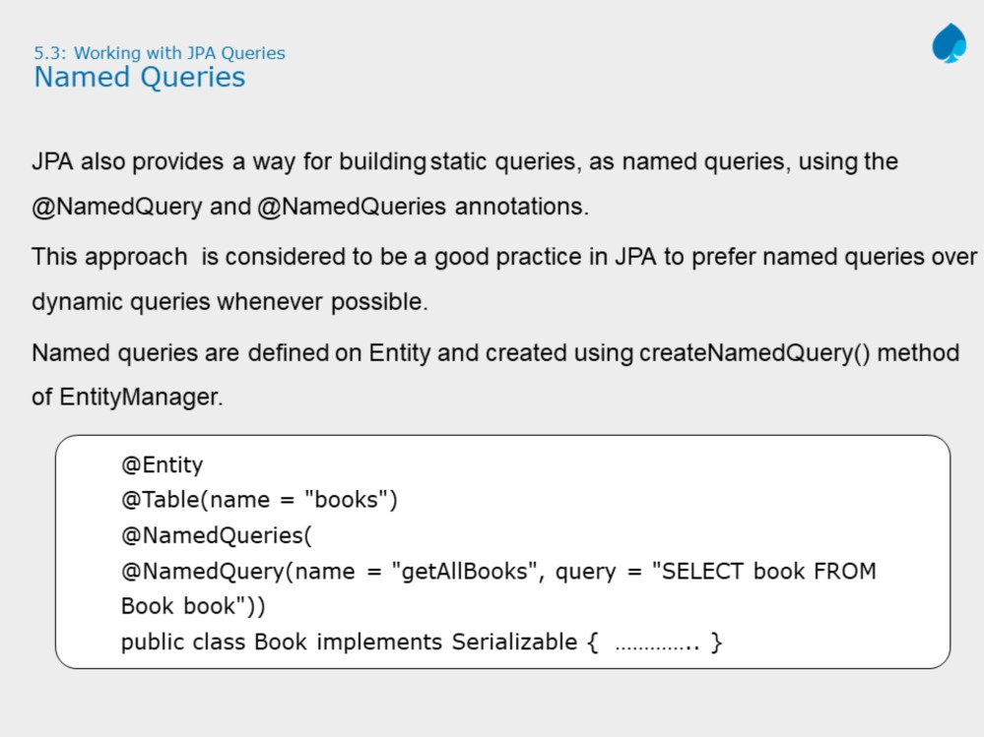

Slide 17
Named queries enables developer to write static queries. Such queries are written on an entity class with class level annotations called @NamedQueries and @NamedQuery.
@NamedQueries accepts array of @NamedQuery, whereas @NamedQuery
requires name and query.
Slide shows an example to create a named query “getAllBooks”. Once defined later on we can create and execute named query as shown below:
Query query = entityManager.createNamedQuery("getAllBooks“);
List<Book> bookList= query.getResultList();

Slide 18
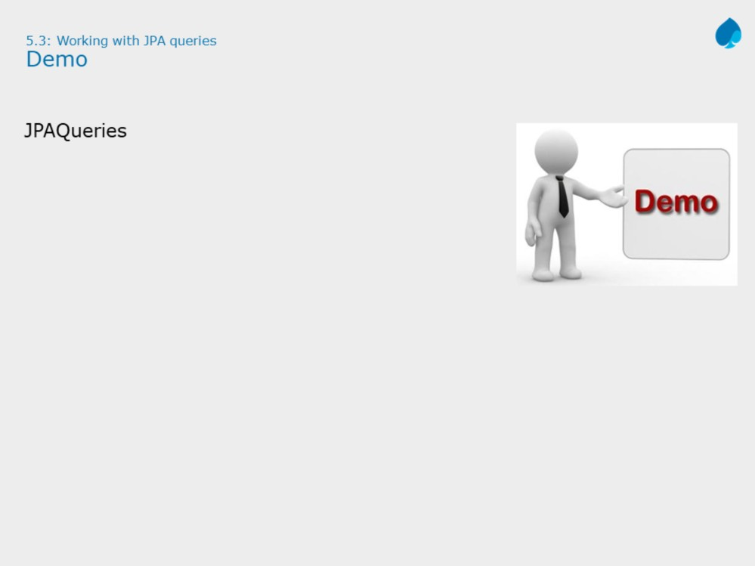

Slide 19
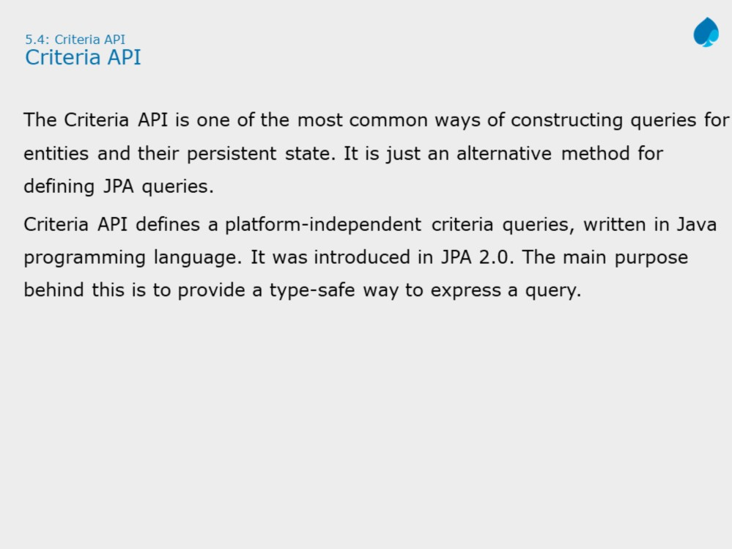
Query query = entityManager.createNamedQuery("getAllBooks");
List<Book> bookList= query.getResultList();

Slide 20
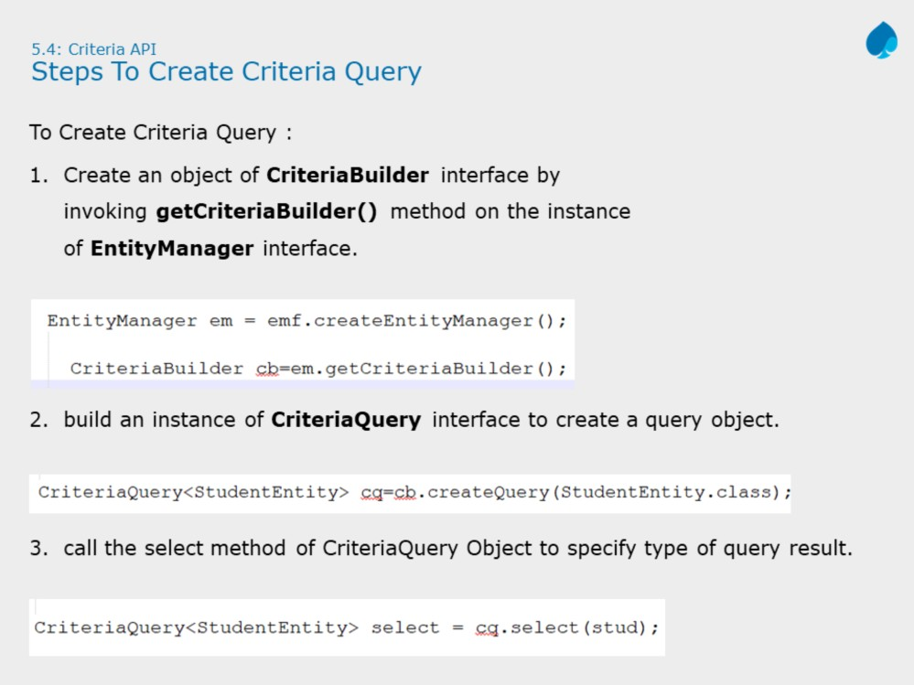
Query query = entityManager.createNamedQuery("getAllBooks");
List<Book> bookList= query.getResultList();

Slide 21
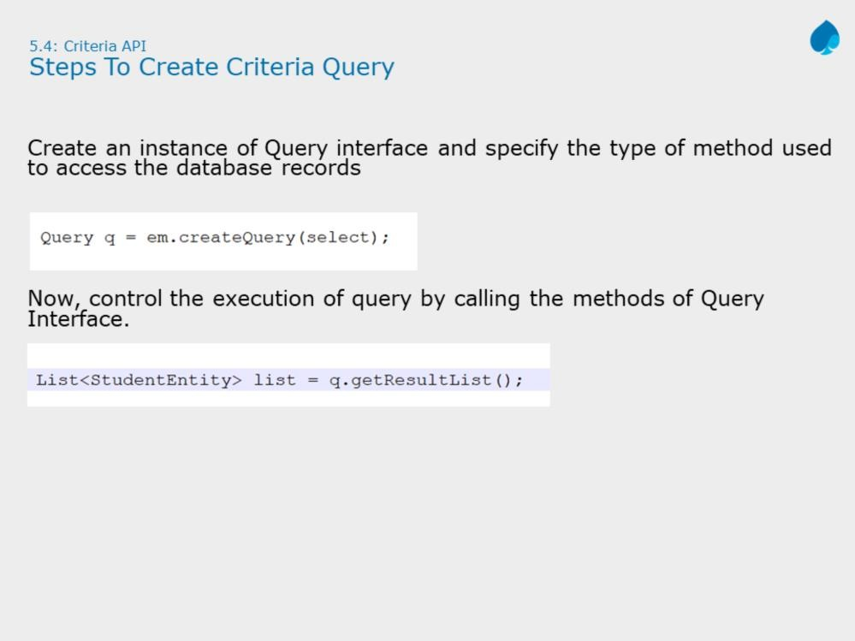

Slide 22
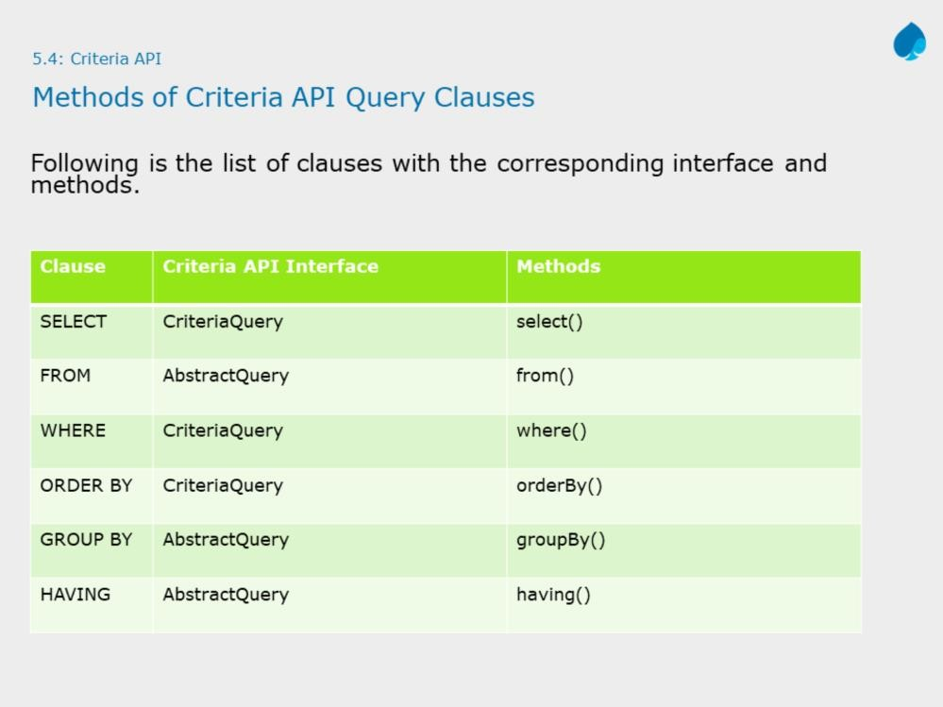

Slide 23
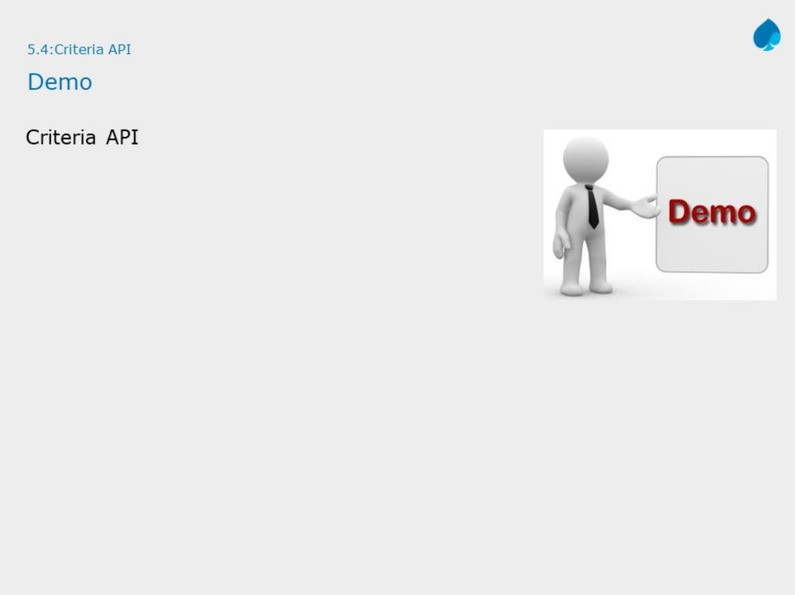

Slide 24
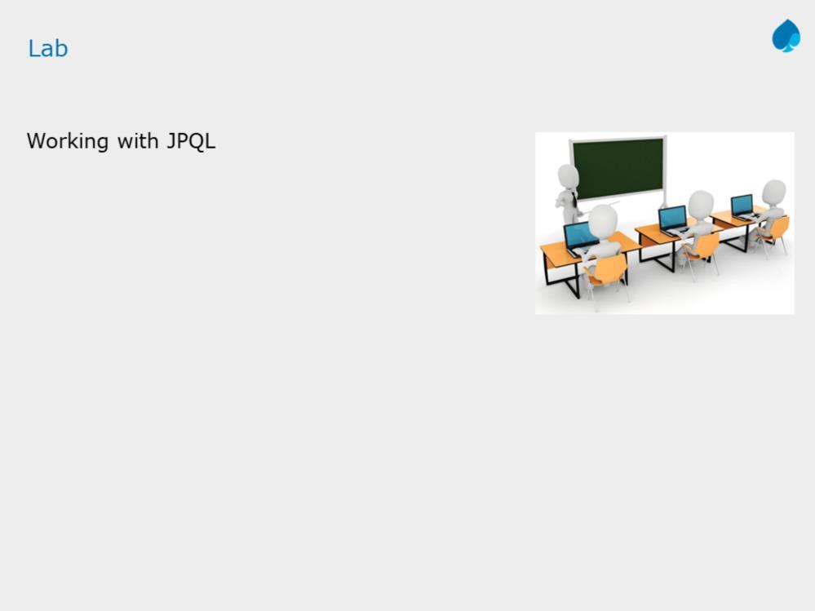

Slide 25
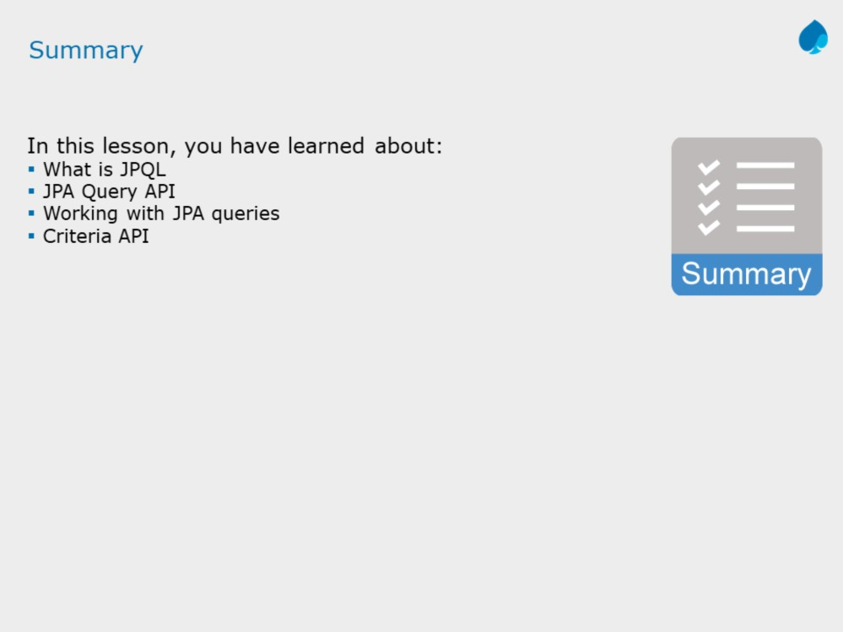

Slide 26
